Slide 1
Can You Predict the Position on an Issue by Analyzing a Comment Letter?

Slide 2

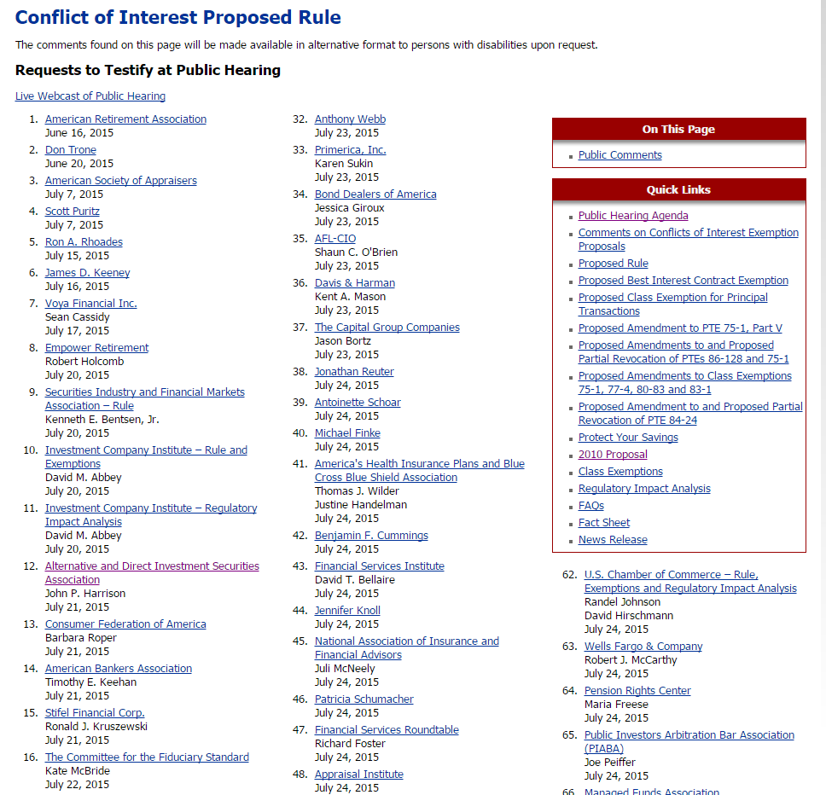
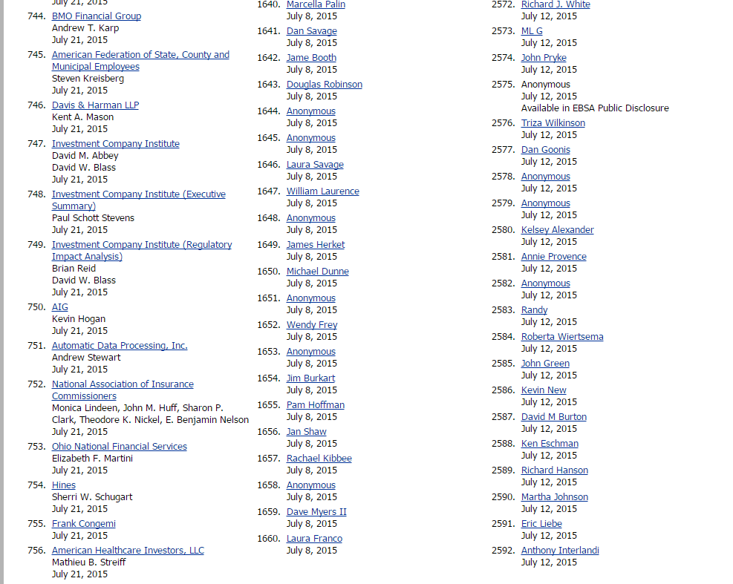
Rulemaking and Comment Process
When considering changes to an existing rule, many federal agencies will ask for comments from interested parties.
Depending on the issue, interested parties may be individuals, businesses, corporations, membership organizations or Members of Congress.
Do people actual respond and provide comments?

Slide 3
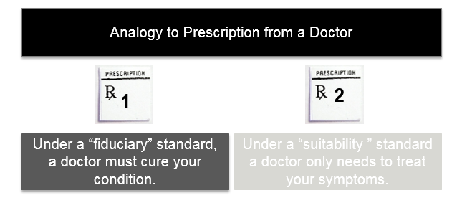
DOL Rulemaking on Conflicted Advice
Updating the rule for the first time in 40 years
New retirement vehicles in existence that were not around

Slide 4
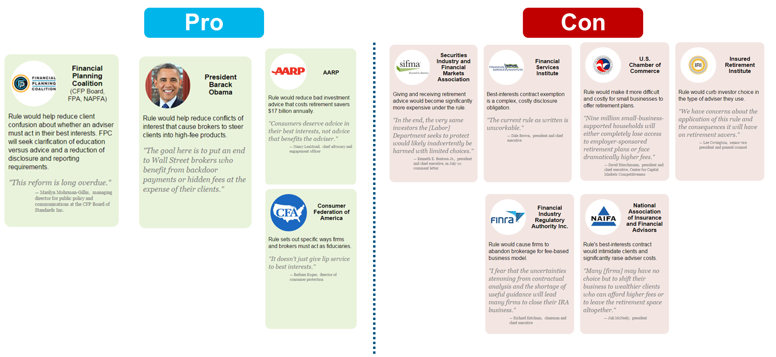
Key Players and Position on the Issue?

Slide 5
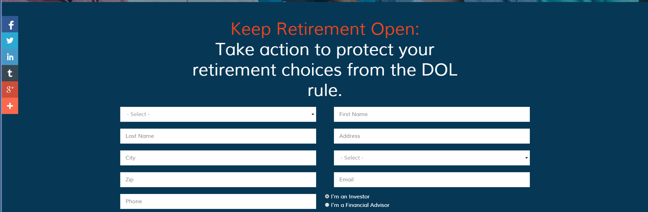
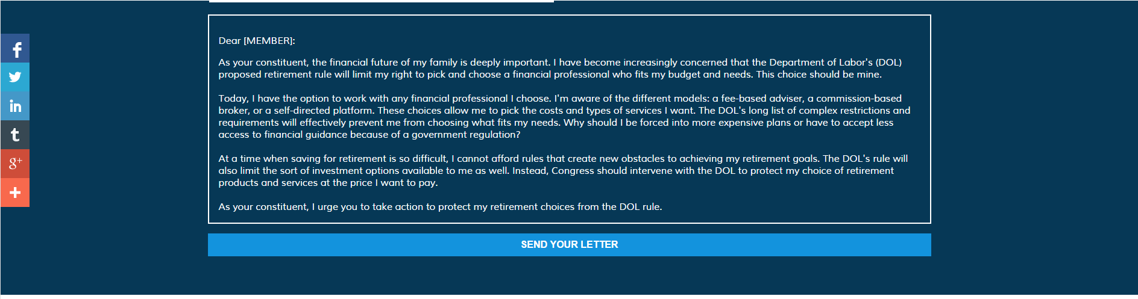
Examining the Record and Cutting through the “Noise”

Slide 6
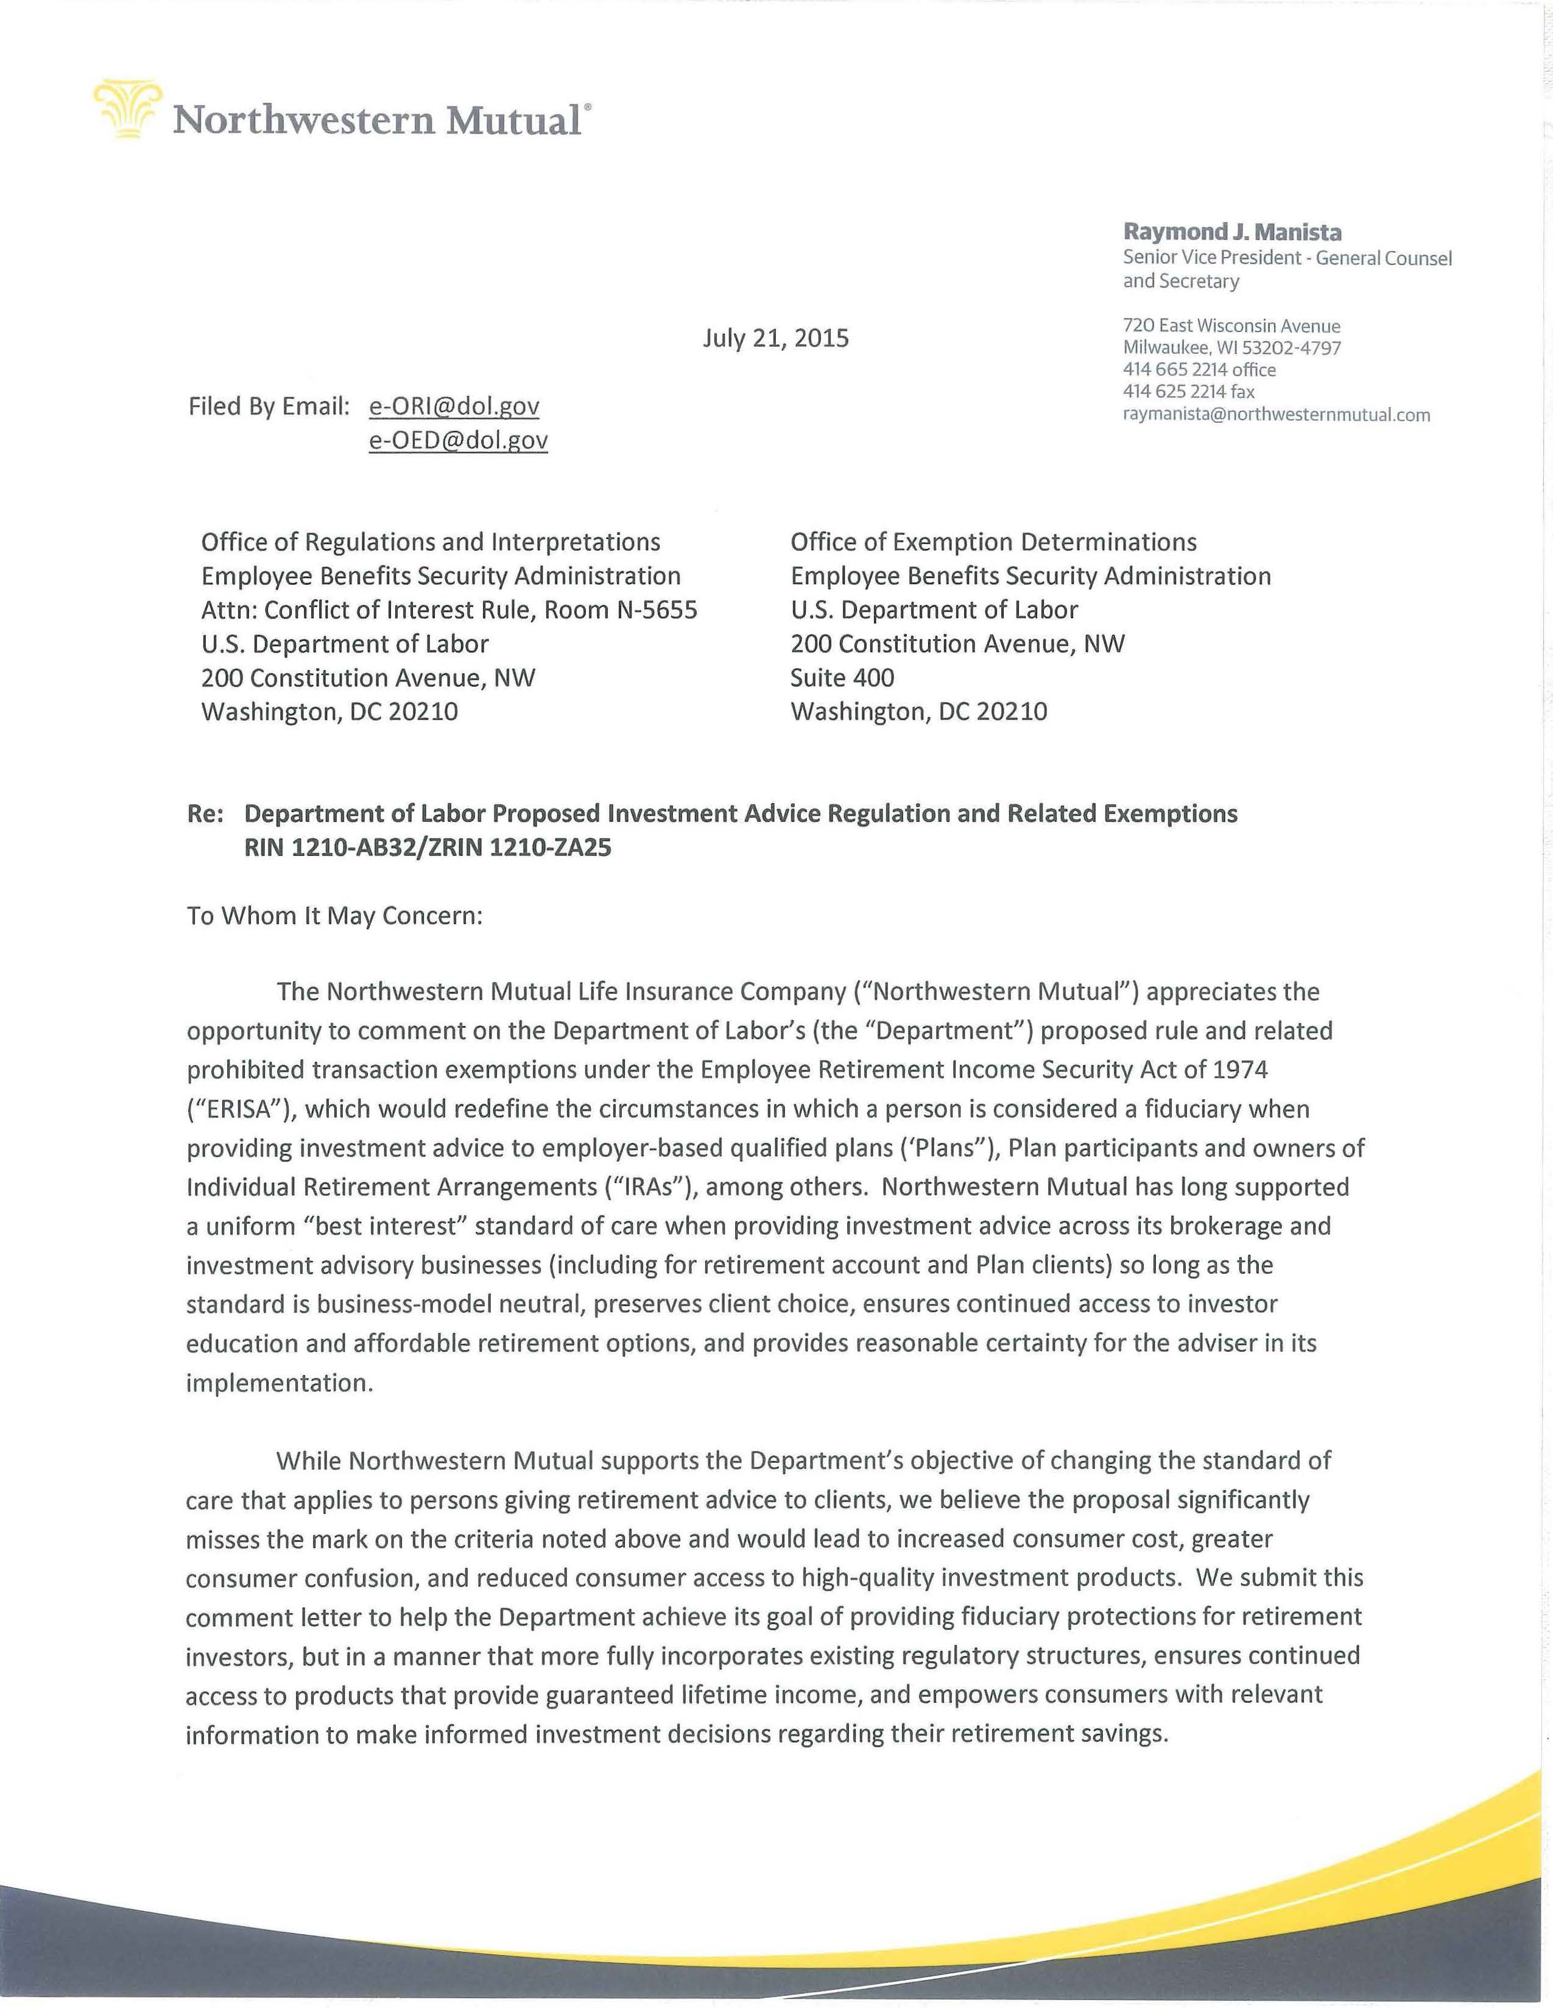
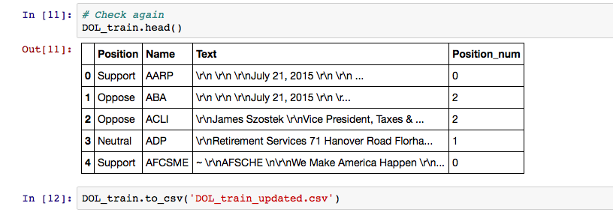
Project Design – Creating a DataFrame
Manually creates csv file with name and position
Download and convert to text letters from training data: 31 Support, 36 Oppose, and 16 Neutral
Create a python list from text file using glob
Append letter text list to a dataframe from initial csv file and import to new csv file
TXT
Python list

Slide 7
Next Steps
Apply NLP analysis – looking to engineer a feature that describes/ gives an overview of arguments used in a letter
Evaluating other NLP tools for further analysis
Fitting a model (Naïve Bayes)

Slide 8
Questions?

